Slide 1
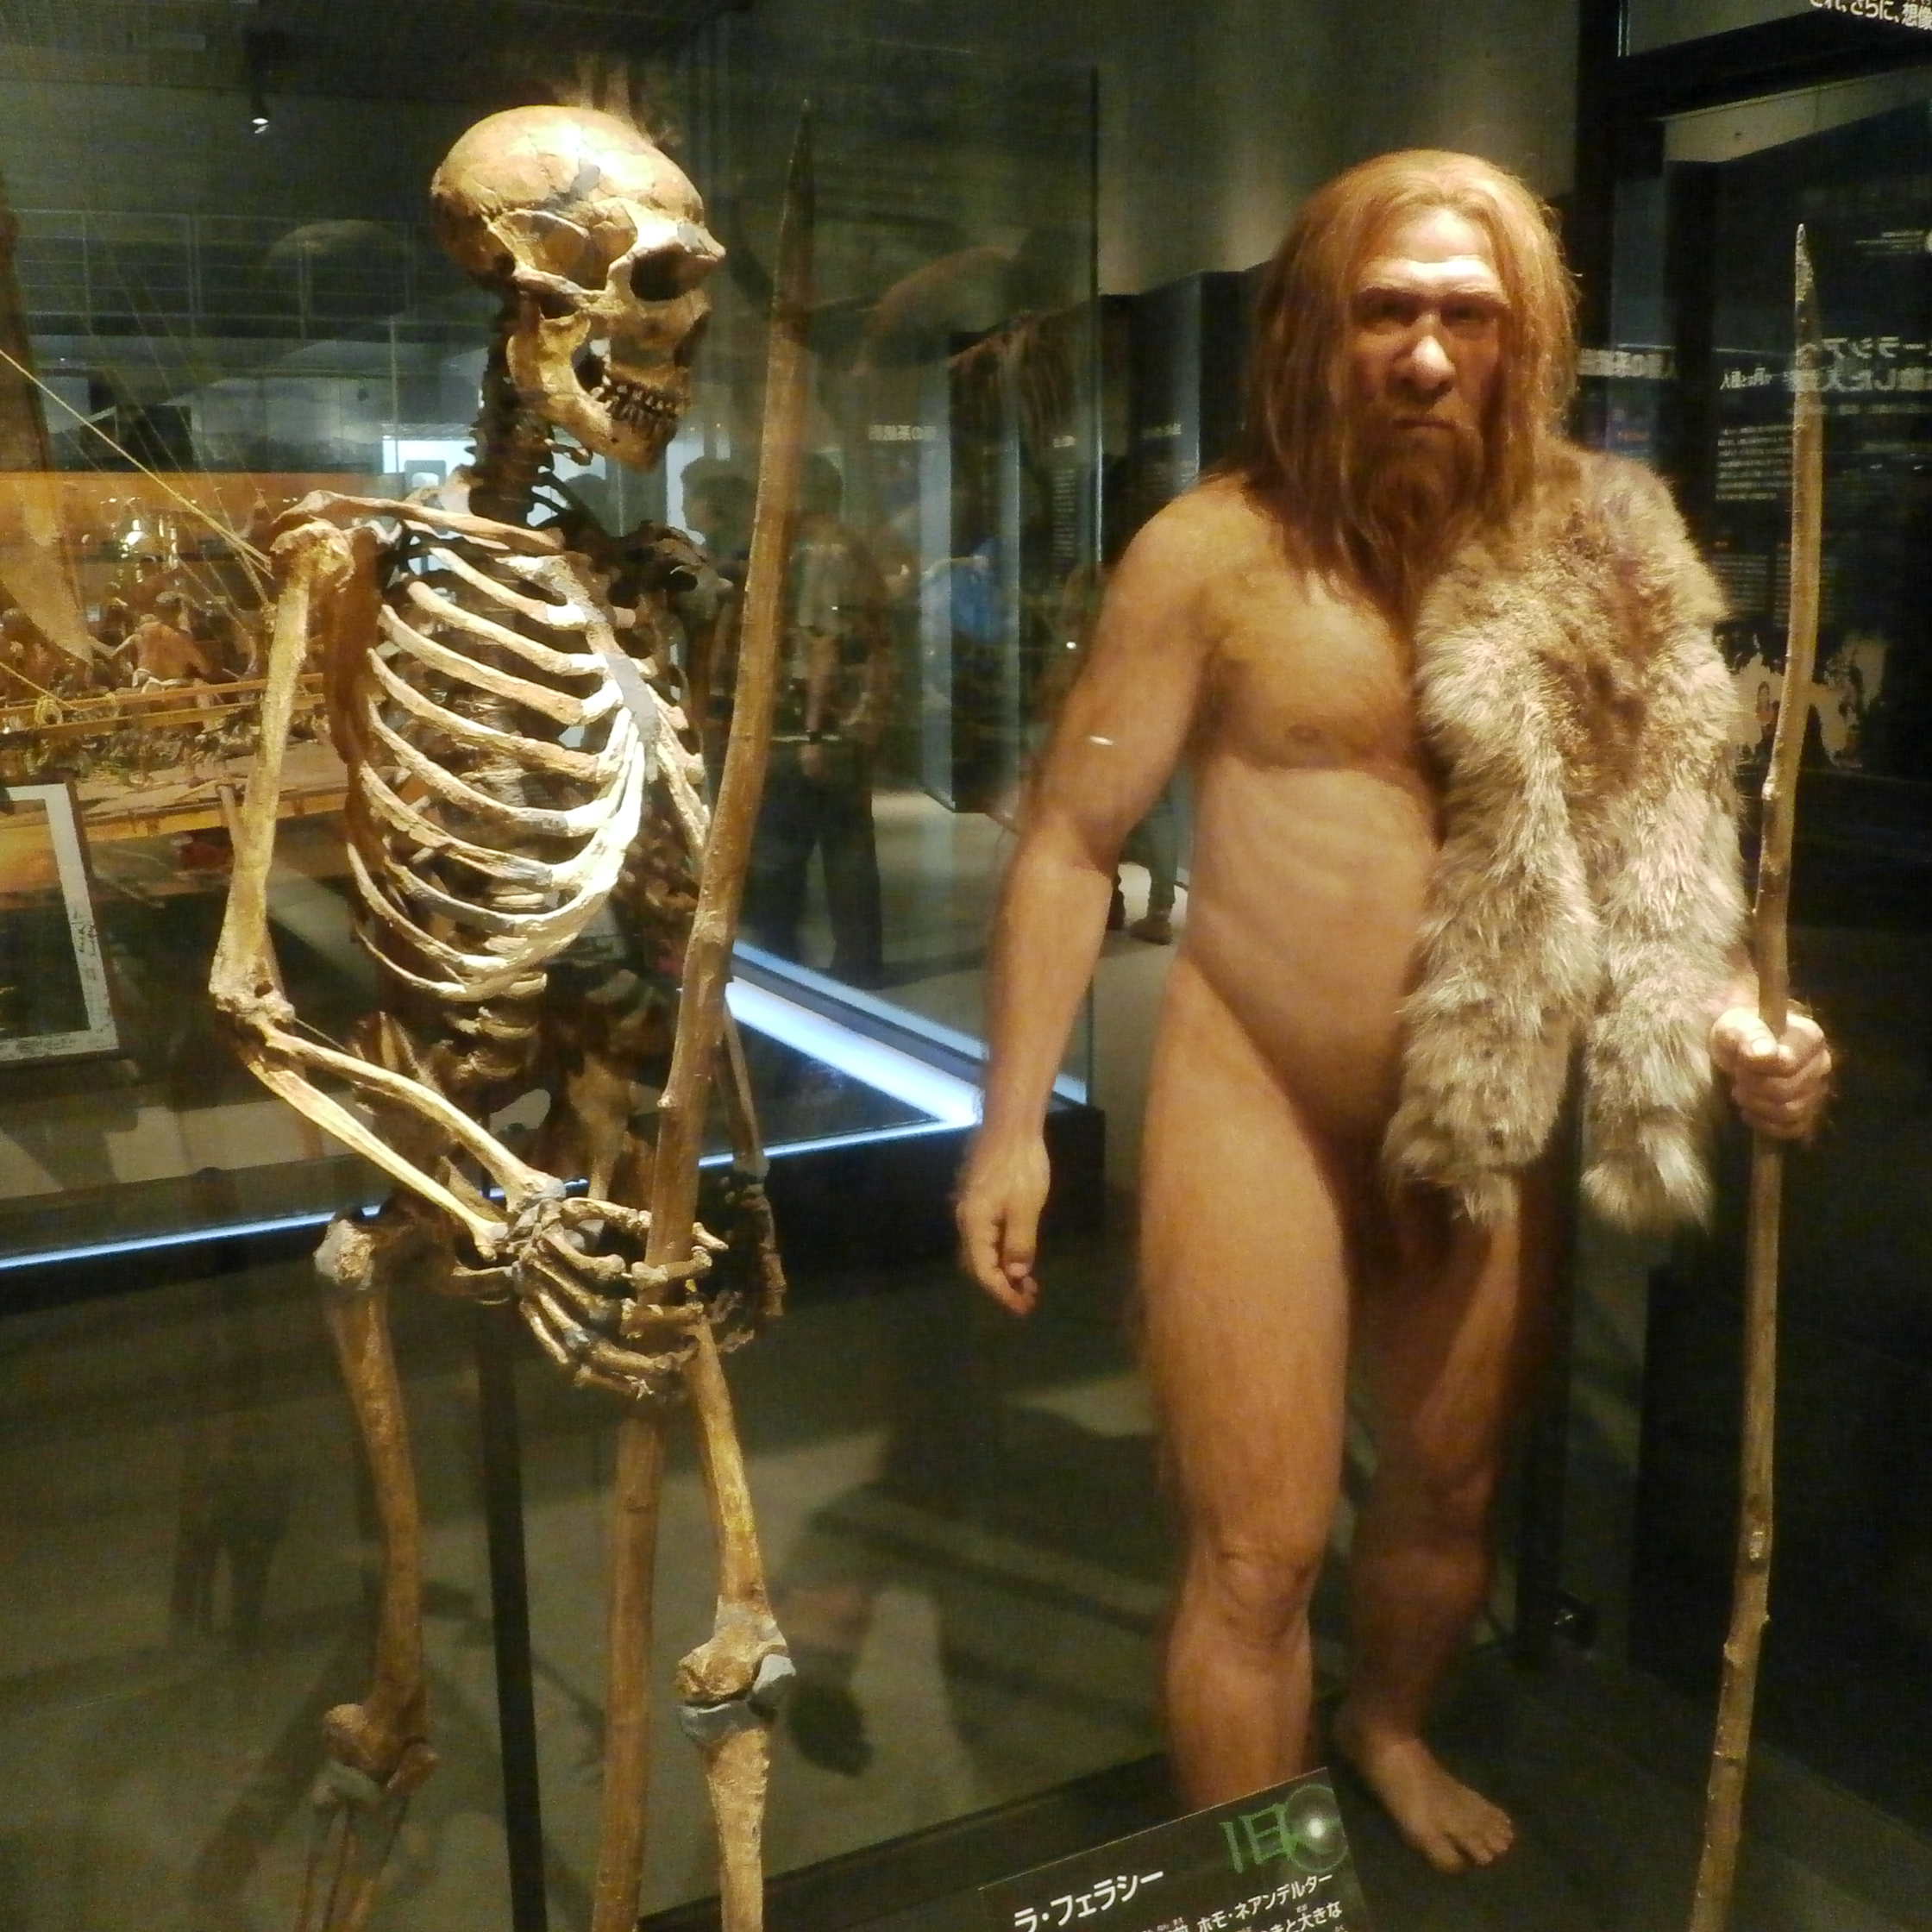

Neanderthals
400,000 - 40,000 years ago
Photo: Photaro, World History Encyclopedia (CC BY-SA 4.0)
Notes:
[Aron] For four hundred thousand years, the Neanderthals survived ice age after ice age.
But their DNA suggests there were never many of them:
Slide notes: Neanderthals lived in Europe and western Asia from about 400,000 to 40,000 years ago and survived many ice ages. Genetic data suggest their population was always small, perhaps only a few thousand breeding adults. Their extinction probably had several causes (climate, disease, competition with modern humans). We use them as a hook: could being few have been enough on its own?

Slide 2
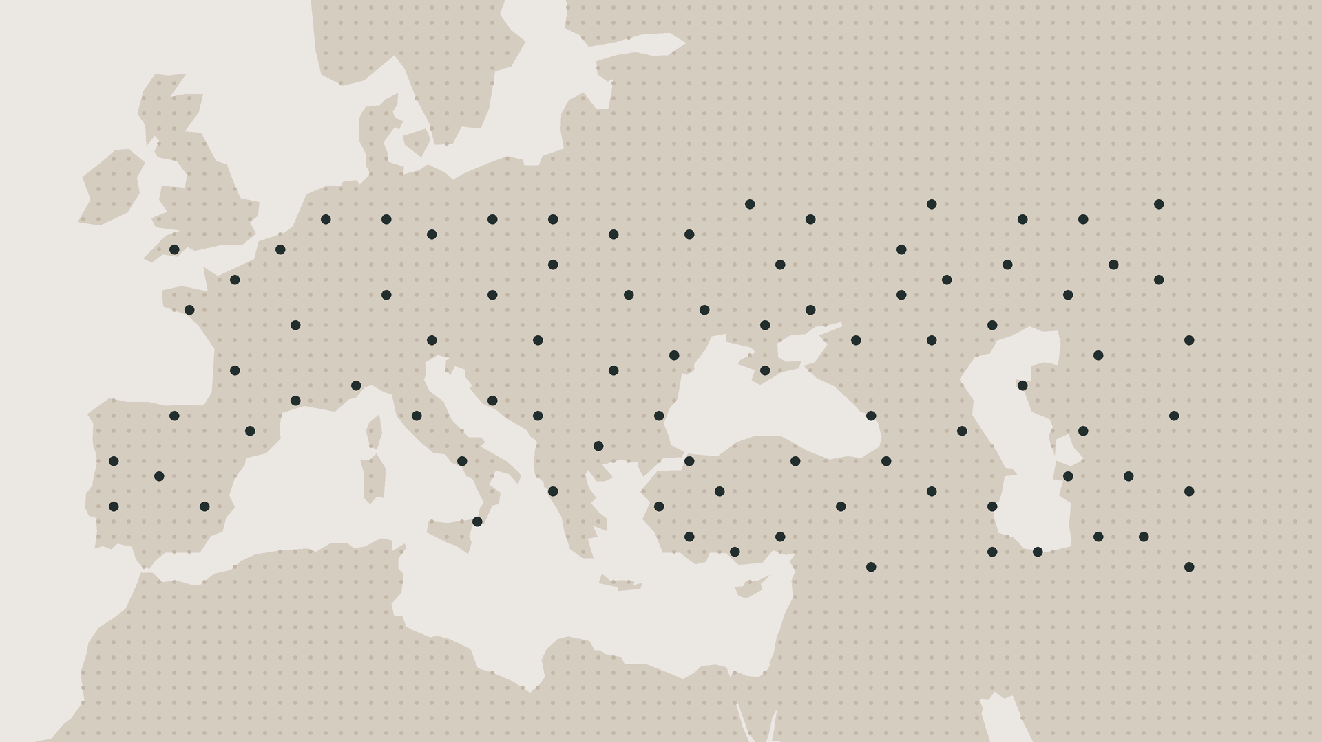
Neanderthals
A few thousand breeding adults
● one small band
Band positions illustrative · Vaesen et al. 2019 · Drawn with AI assistance (Claude)
Notes:
[Aron] perhaps only a few thousand breeding adults, spread across all of Europe.
Around forty thousand years ago, they vanished. Climate, disease and competition from us probably all played a part. But one study by Vaesen et al asked a simpler question: could being that few have been enough on its own?
Slide notes: Each dot is one small band of Neanderthals spread across Europe. The positions are illustrative, not real sites. The point is how few and how scattered they were: neighbouring bands could be far apart, which makes finding mates and sharing help harder.

Slide 3
Many neighbours
Few neighbours
Competitors
more for each
● one individual ○ its food and space
Schematic after Stephens et al. 1999
Notes:
[Aron] To see why it might, start with what you’d expect. When a population shrinks, you'd expect the survivors to do better: less competition means more food and space for each one.
Slide notes: The usual expectation (negative density dependence): when a population shrinks, each survivor has more food and space, so it should do better. Each dot is one individual and the circle around it is its share of resources. With few neighbours, each circle is bigger.

Slide 4
Many neighbours
Few neighbours
Competitors
more for each
Partners
fewer helpers
● one individual ○ its food and space — a partner
Schematic after Stephens et al. 1999
Notes:
[Aron] But neighbours aren't just competitors. They're also partners, lookouts and teammates, and losing too many of them may leave each individual worse off.
Slide notes: Neighbours are not only competitors. They are also mates, lookouts and helpers (lines show partners). With too few neighbours, each individual loses that help. This is the idea behind the Allee effect: at low numbers, the cost of losing partners can outweigh the benefit of less competition.

Slide 5
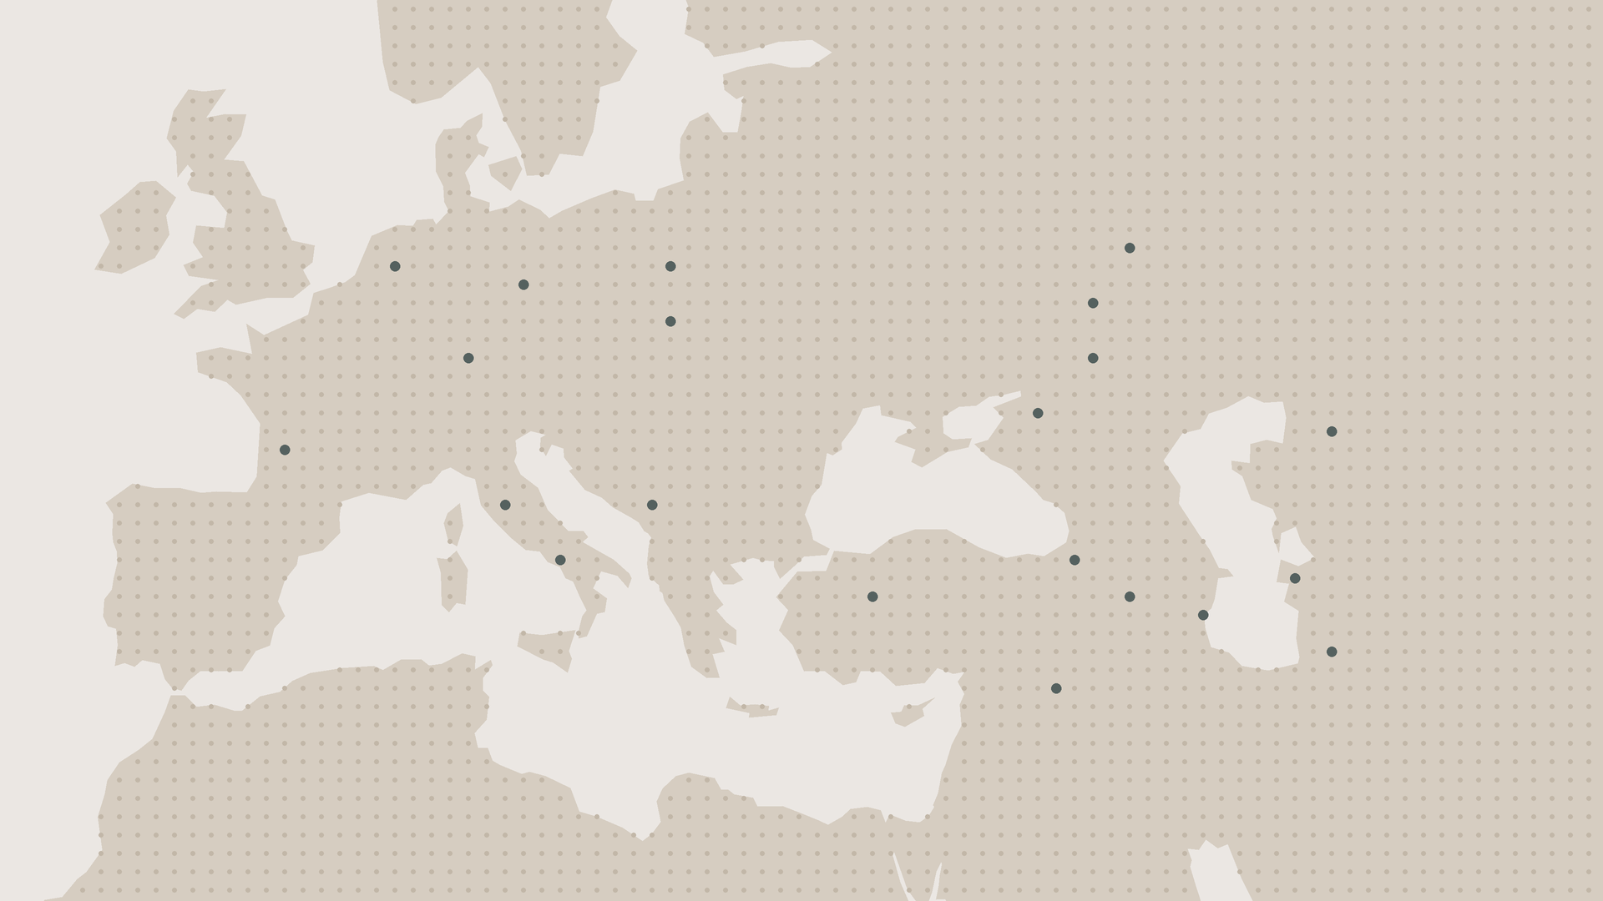
Neanderthals
In the simulation
● one small band
Band positions illustrative · Vaesen et al. 2019 · Drawn with AI assistance (Claude)
Notes:
[Aron] And that’s what the simulation found: as groups shrank, the birth rate dropped,
Slide notes: Vaesen et al. built a model of small Neanderthal bands that included inbreeding, Allee effects and chance events. In the simulation, as bands shrank, individuals found mates less often and the birth rate dropped.

Slide 6
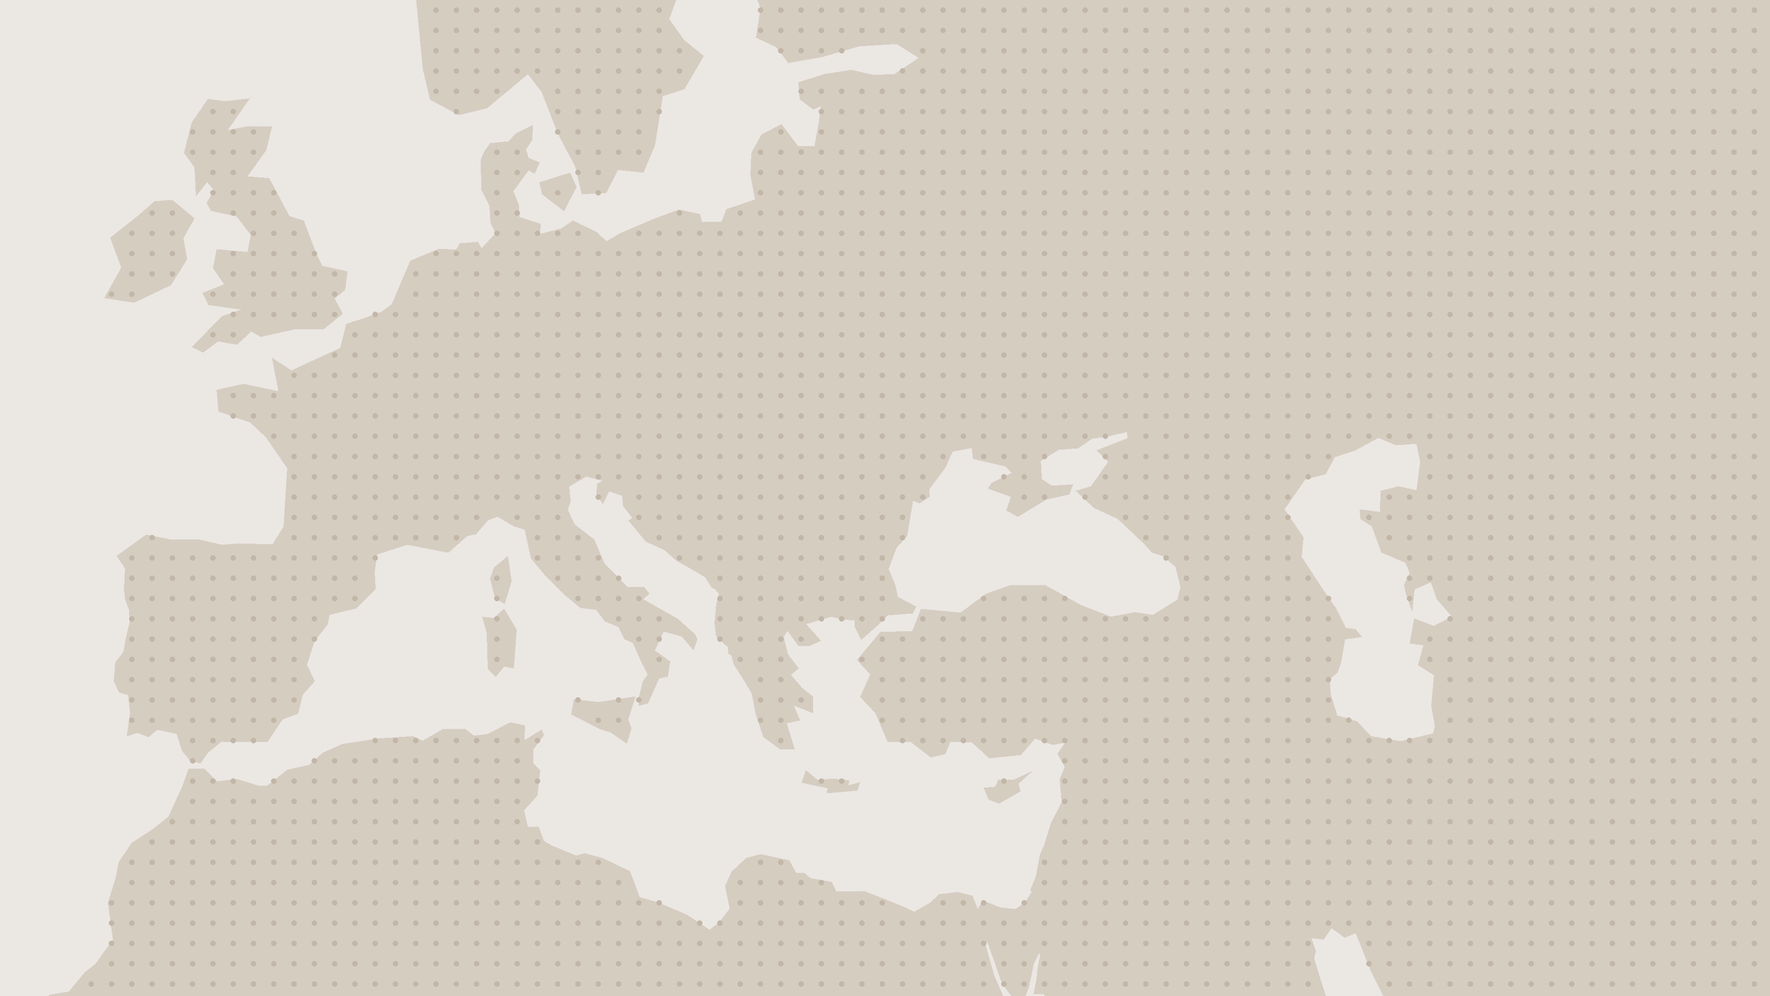
Neanderthals
In the simulation
● one small band
Band positions illustrative · Vaesen et al. 2019 · Drawn with AI assistance (Claude)
Notes:
[Aron] shrinking the population further, all the way to extinction.
Slide notes: The lower birth rate shrank the population further, which lowered the birth rate again: a feedback loop that ran to extinction in the model. This shows that small size alone could have been enough. It is a simulation, so it shows what was possible, not what happened.

Slide 7
The Allee effect
The smaller the population, the lower each individual's chance of surviving or reproducing.
Source: Stephens et al. 1999
Notes:
[Zoe] This concept is called the Allee effect: the smaller the population, the lower each individual’s chance of surviving or reproducing.
Slide notes: Definition: the smaller the population, the lower each individual's chance of surviving or reproducing. In other words, a positive relationship between individual fitness and population size or density at low numbers. Named after W.C. Allee, who described it in the 1930s.

Slide 8
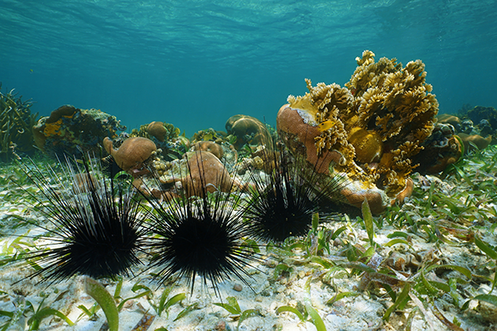
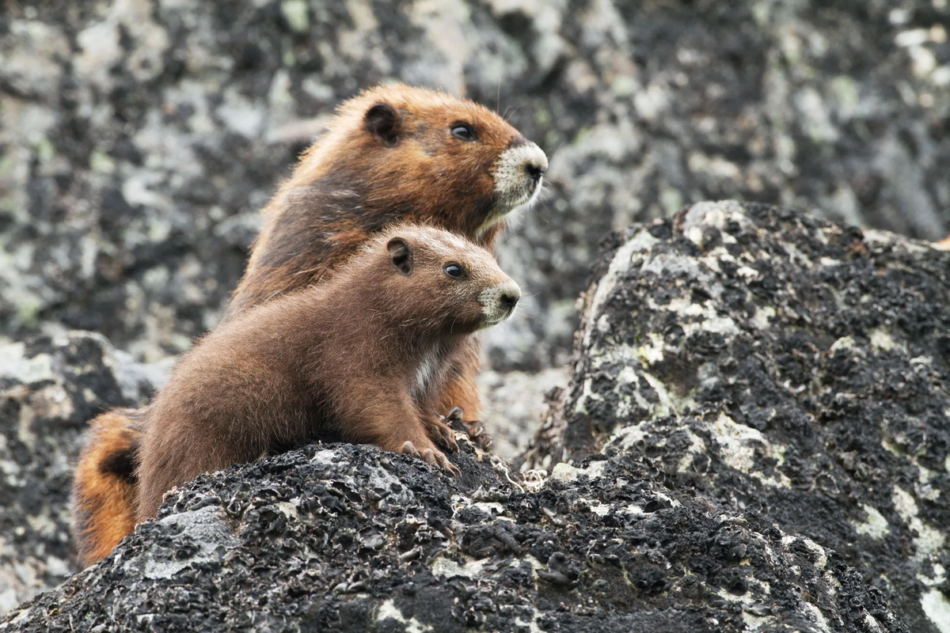
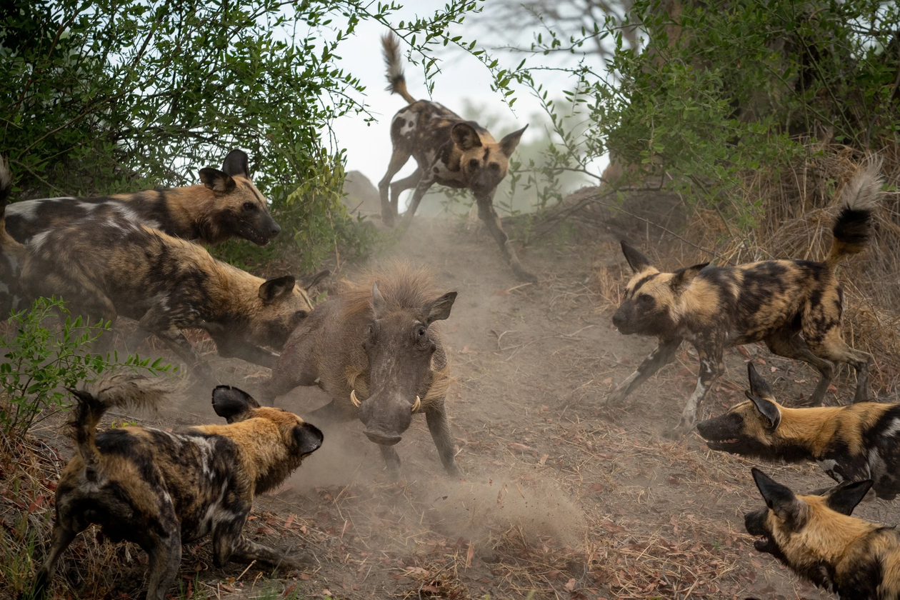
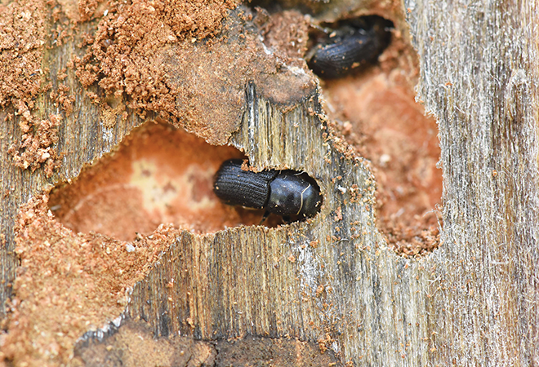
Mechanisms of the Allee effect
Mates
Sea urchins
Safety
Island marmots
Teamwork
African wild dogs
Changing habitat
Bark beetles
Sources: Gascoigne et al. 2009 · Brashares et al. 2010 · Courchamp et al. 1999 · Branco et al. 2024
Photos: see image credits
Notes:
[Zoe] So why would being few hurt?
First, finding a mate. Spread thin, individuals struggle to meet: for example sea urchins, who fertilise fewer eggs the further apart they are.
Second, safety. A group has more eyes, and a predator can only eat so many, so each animal’s risk is diluted. Vancouver Island marmots, now down to a few scattered animals, spend ten times longer on lookout than they used to, and feed far less.
Third, teamwork. African wild dogs hunt and raise their pups together, and packs of fewer than four adults are thought to be unable to breed successfully.
Fourth, changing their surroundings: bark beetles can only overcome a tree’s defences if enough of them attack at once.
But here’s the catch. Being few also has an upside: less competition. So a population only shrinks if these costs outweigh that benefit, and in the wild, that balance is very hard to measure.
Slide notes:
Four common reasons why being few hurts:
- Mates: spread-out individuals struggle to meet. Sea urchins release eggs and sperm into the water, so fewer eggs are fertilised when urchins are far apart.
- Safety: groups have more eyes and dilute each animal's predation risk. Vancouver Island marmots, now few and scattered, spend much more time on lookout and much less time feeding.
- Teamwork: African wild dogs hunt and raise pups together. Packs of fewer than about four adults are thought to be unable to breed successfully.
- Changing habitat: bark beetles can only overcome a tree's defences if enough attack at once.
Catch: being few also means less competition, so a population only declines if these costs outweigh that benefit.

Slide 9
The Allee effect
Are Allee effects an ecological curiosity, or a fundamental driver of population dynamics?
Notes:
[Zoe] So our question is: are Allee effects an ecological curiosity, or a fundamental driver of population dynamics?
Slide notes: Are Allee effects an ecological curiosity (seen in a few odd species) or a fundamental driver of population dynamics? To answer it we look at the types of Allee effect, then at how strong the evidence is.

Slide 10
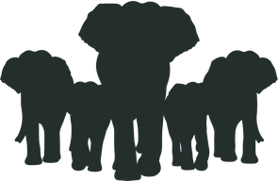


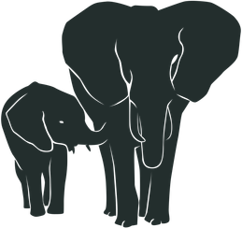
Component Allee effect
“A positive relationship between a specific component of individual fitness and population density”
– Muir et al. 2024
One fitness component gets worse at lower numbers
Examples of fitness components
Reproductive success
Survival
Mate finding
Offspring survival
Quote: Muir et al. 2024, p. 2, after Stephens et al. 1999
Notes:
Slide notes: A component Allee effect is "a positive relationship between a specific component of individual fitness and population density". A fitness component is one measurable part of fitness: survival, reproductive success, mate finding, offspring survival. A component effect does not mean the whole population is declining. It only means one part of fitness gets worse at low numbers, and other parts (such as less competition) may make up for it.

Slide 11
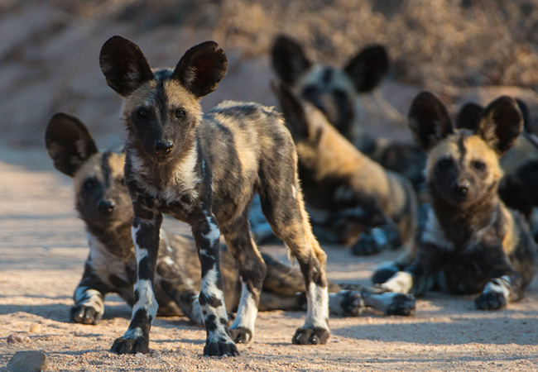
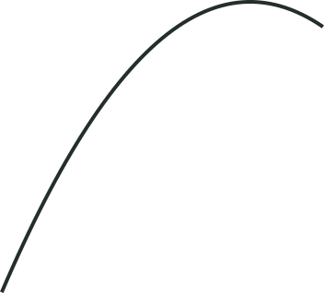
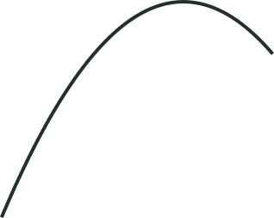
Component Allee effect: African wild dog
Pups produced per dog
per capita productivity
Pup survival
% of pups surviving
1.0
100
0.8
80
0.6
60
Photo: Sabi Sabi Private Game Reserve, via Africa Endeavours
0.4
40
Why pack size matters
Hunt cooperatively, defend each other, help care for pups
0.2
20
0.0
0
Fewer pack members
0
4
8
12
16
0
4
8
12
16
Less cooperative support, so lower reproductive success and pup survival
Pack size
Pack size
Each dot: one pack in one year
Data: Angulo et al. 2013, Fig. 2B, 2F; values digitised, approximate. Drawn with AI assistance (Claude)
Notes:
Slide notes:
How to read it: both charts have pack size on the horizontal axis. Each dot is one pack in one year. Left: pups produced per dog (per capita productivity). Right: percentage of pups that survived.
What it shows: small packs produced fewer pups per dog and fewer of their pups survived. Both measures rose with pack size and peaked at about 11 (productivity) and 12 (pup survival) members. These are component Allee effects, because each is one part of fitness.
Key caveat: the effect was linked to pack size, not total population size. The study found no detectable demographic Allee effect at the population level.

Slide 12
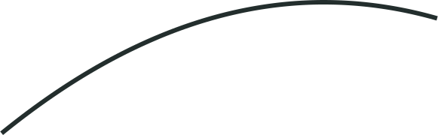
Component and demographic Allee effects: Vancouver Island marmot
Component Allee effect
Each marmot does worse
Demographic Allee effect
The whole population grows more slowly
Fewer neighbors (marmots per colony)
0.2
Time spent feeding
0.0
no growth
Population growth
-57%
-86%
−0.4
0
100
200
300
400
Population size
1973
2006
1970s
2002–05
−57%: our calculation, 8.3 to 3.6 marmots per colony
Each dot: one year, 1970–2007. Curve: quadratic fit, R² = 0.55
Data: Brashares et al. 2010, Fig. 1 and p. 966; terms: Stephens et al. 1999. Drawn with AI assistance (Claude)
Notes:
Slide notes:
Left (individual level): from the 1970s to 2002-05, colonies shrank from about 8.3 to 3.6 marmots (-57%, our calculation) and time spent feeding fell by about 86%. Survivors also greeted each other less, heard fewer alarm calls and spent more time watching for predators. Fewer neighbours is the cause; less feeding and more vigilance are behavioural costs that can lower survival and reproduction. They are the route to a component effect, not fitness measures themselves.
Right (population level): each dot is one year, 1970-2007. Horizontal axis: population size. Vertical axis: growth per marmot. The curve (quadratic fit, R² = 0.55) shows that smaller populations grew more slowly, and at the smallest sizes growth was negative. That is a demographic Allee effect: the costs add up to the whole population's growth rate.
Caveat: these are field data, not an experiment. Predators also increased, so the authors say only reintroductions can prove the cause.

Slide 13
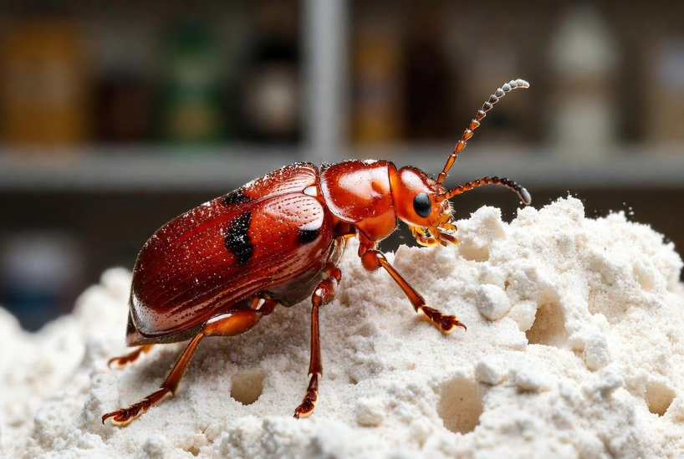
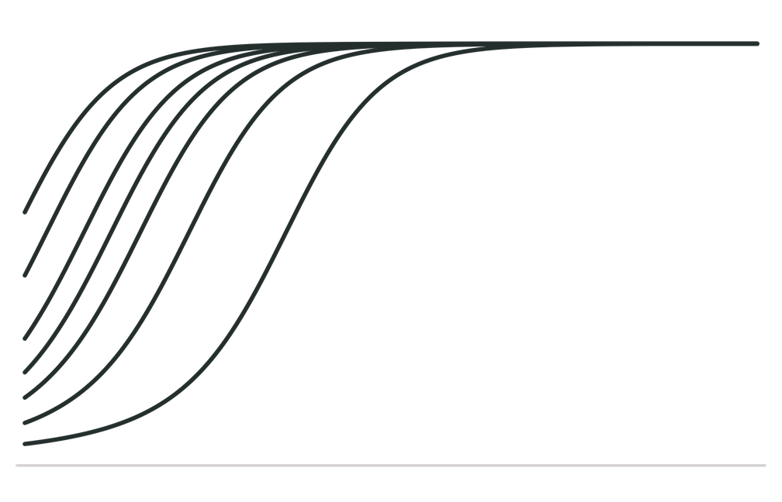
Strong and weak Allee effects
Weak: small populations grow more slowly
Population size
Flour beetle
Offspring per female rise with density: a component effect that can add up to a weak Allee effect.
Time →
Each line: one population
Schematic after Drake & Kramer 2011; flour beetles: Allee 1938, in Courchamp et al. 1999. Drawn with AI assistance (Claude)
Notes:
Slide notes:
How to read it: each line is one population's size over time. In a weak Allee effect, small populations grow more slowly than larger ones, but growth per individual stays above zero. There is no threshold, so even a tiny population can still grow.
Flour beetle (Tribolium): in Allee's lab experiments, reproduction per female per day was lowest at very low densities and highest at intermediate densities. This is a component measure (one part of fitness). A cost like this can add up to a weak Allee effect at the population level.

Slide 14
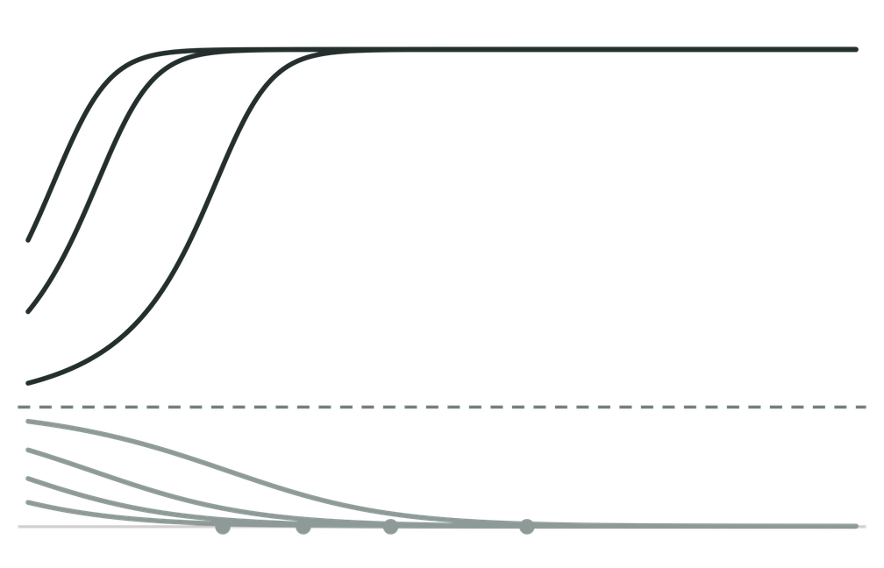
Strong and weak Allee effects
Weak: small populations grow more slowly
Strong: below threshold, more die than are born
Population size
Population size
Threshold
Extinct
Time →
Time →
Each line: one population
Schematic after Drake & Kramer 2011; flour beetles: Allee 1938, in Courchamp et al. 1999. Drawn with AI assistance (Claude)
Notes:
Slide notes:
Left (weak): small populations grow slowly but still grow. Right (strong): there is a critical size, the Allee threshold. Below it, growth per individual is negative (more die than are born), so the population shrinks on its own and goes extinct unless immigrants or management help. Above it, the population grows.
Key difference: weak = lower but positive growth at low numbers; strong = negative growth below a threshold. Only a strong Allee effect creates a point of no return.

Slide 15
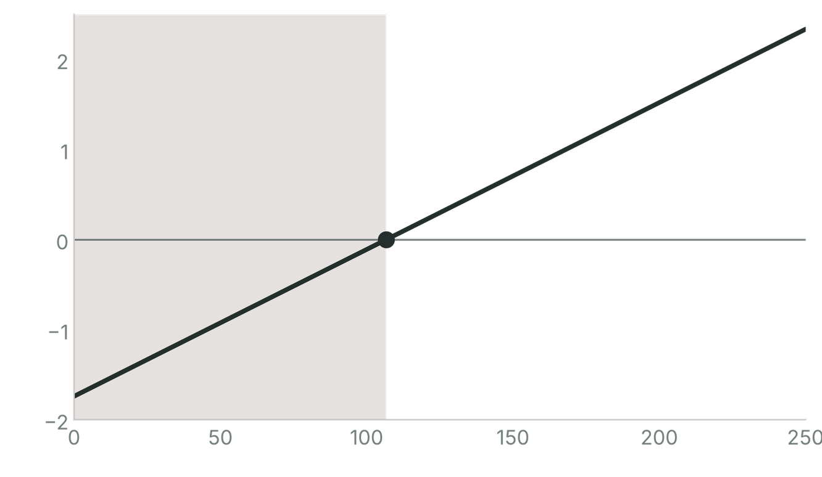

Strong and weak Allee effects: a real threshold
Shrinking colonies
Growth per individual (log)
≈107
Photo: Tamás Nestor, Butterfly Conservation
Gypsy moth
Males trapped per colony
Below ≈107 males, colonies tend to shrink on their own, with chance deciding a lot
225 colony-years of trap data from new colonies, USA; data points not shown
Fit: Liebhold & Bascompte 2003, Fig. 1b; regression line only. Drawn with AI assistance (Claude)
Notes:
Slide notes:
The gypsy moth is invasive in North America and spreads by founding small, isolated colonies, where males struggle to find females.
How to read it: horizontal axis = males caught in pheromone traps per colony (a proxy for colony size). Vertical axis = growth from one year to the next, on a log scale: zero means no change, below zero means the colony shrank. The line is the fitted regression from 225 colony-years of trap data; the data points are not shown.
What it shows: the fitted line crosses zero at about 107 males. Below that, colonies are expected to shrink; above it, to grow. This is evidence of a strong Allee effect.
Caveats: about 107 is an estimate from the fitted line, not a sharp cliff. Most data points were at low counts, real colonies scattered widely around the line, chance played a big role, and some colonies below the threshold survived.
Why it matters: to eradicate an invader you do not have to kill every individual, only push colonies below the threshold.

Slide 16
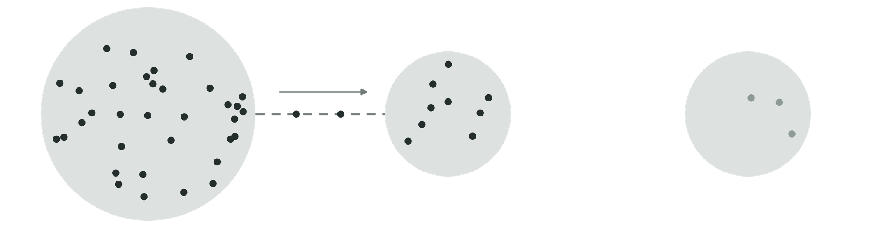
Rescue and immigration
Whether Allee effects act as a "fundamental driver"
depends partly on connectivity.
immigrants
Connected
immigrants top it up: the rescue effect
Isolated
no one comes to the rescue
Source
a large population
● one individual ○ a habitat patch - - dispersal
Source: Brown & Kodric-Brown 1977 · Drawn with AI assistance (Claude)
Notes:
Slide notes:
Whether Allee effects act as a fundamental driver depends partly on connectivity. In a metapopulation (a network of subpopulations linked by dispersal), a small subpopulation near its Allee threshold can be topped up by immigrants from a large source population. This is the rescue effect, and it can stop a subpopulation from going locally extinct. An isolated subpopulation gets no rescue.

Slide 17
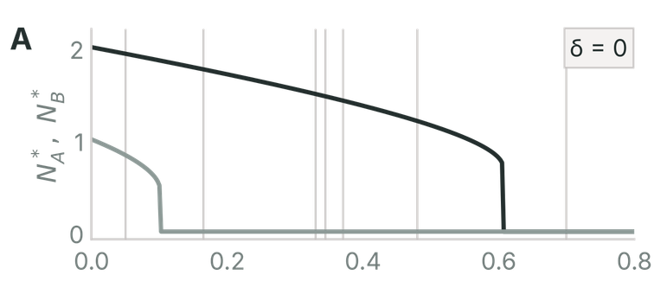
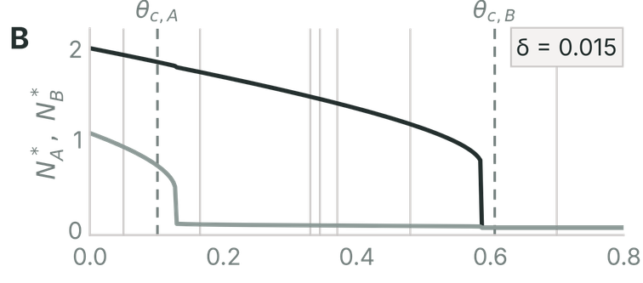
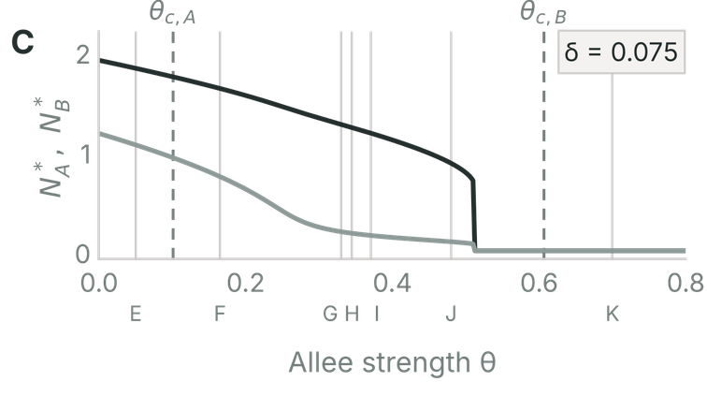
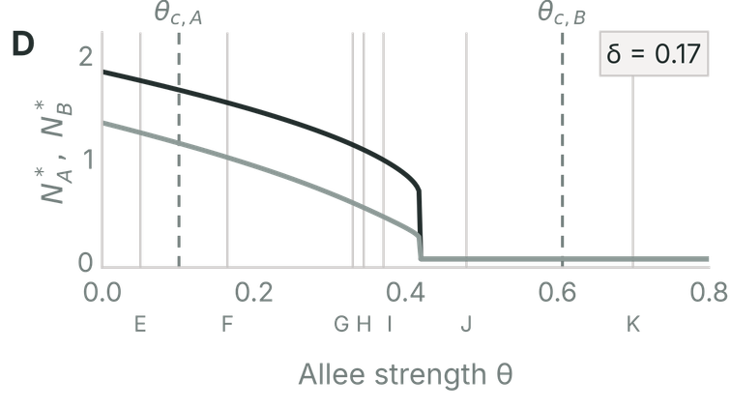
Allee pits: pros and cons of connectivity
Population size of each patch (N*) as Allee strength θ increases
No dispersal (δ = 0)
Dispersal δ = 0.015
Large patch B
Small patch A
θc,i: critical Allee strength (above it, an isolated patch dies out)
E–K: θ values used on the next slide
Dispersal δ = 0.075
Dispersal δ = 0.17
Just above θc,A the total population takes a big benefit from more connectivity and the rescue effect.
Model: Grumbach & Hilker 2025, Fig. 3A–D, recomputed. Drawn with AI assistance (Claude)
Notes:
Slide ntoes:
A two-patch model with a small patch A and a large patch B. Allee strength (θ) is how strong the Allee effect is; dispersal rate (δ) is how connected the patches are.
How to read it: each panel shows the equilibrium size of each patch (N*) as Allee strength θ increases, at a different dispersal rate (δ = 0, 0.015, 0.075, 0.17). θc is the critical Allee strength: above it, an isolated patch dies out.
What it shows: just above the small patch's critical strength, more connectivity helps a lot, because the big patch rescues the small one. But dispersal also drains individuals from patches, so stronger rescue can lower the Allee strength at which the whole metapopulation goes extinct. Connectivity can help or hurt.

Slide 18
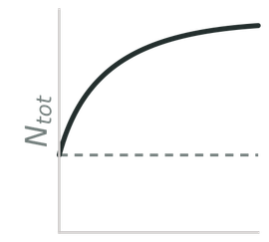
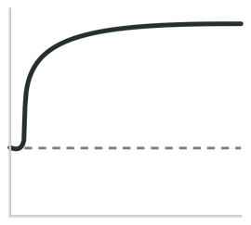
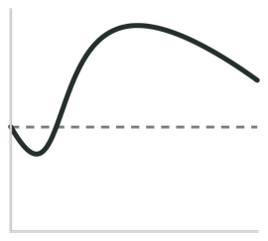
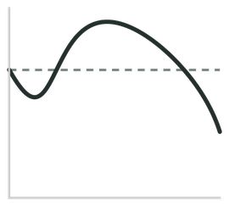
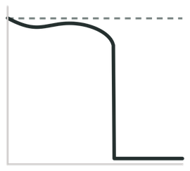
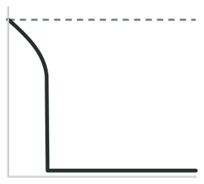
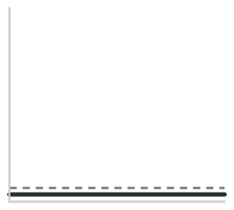
Allee pits: reaction at different Allee strengths
Each panel: total population (up) against dispersal rate δ (across). Dashed: no dispersal.
E (MB)
F (pit–MB)
G (pit–UB)
H (pit–BTD)
I (pit–MD)
J (MD–Extinct)
K (Extinct)
dispersal rate δ
θ = 0.05
θ = 0.165
θ = 0.33
θ = 0.345
θ = 0.371
θ = 0.48
θ = 0.7
Allee strength rises →
MB monotonically beneficial
UB unimodally beneficial
Allee pits occur when habitat connectivity causes a subpopulation to fall below a critical Allee threshold without getting enough rescue from neighbouring patches.
BTD beneficial turning detrimental
MD monotonic decrease
pit– with an Allee pit first
Model: Grumbach & Hilker 2025, Fig. 3E–K, recomputed. Drawn with AI assistance (Claude)
Notes:
Slide notes:
How to read it: each panel shows total population size (vertical) against dispersal rate δ (horizontal) for one fixed Allee strength θ, from weak (E, θ = 0.05) to strong (K, θ = 0.7). Dashed line: no dispersal.
What it shows: at weak Allee strength, more dispersal always helps (MB, monotonically beneficial). As θ rises, an "Allee pit" appears first: at low-to-moderate dispersal, the small patch loses too many individuals and falls below its Allee threshold without enough rescue, so the total population drops below the no-dispersal level. At higher θ, dispersal turns from beneficial to harmful (BTD, MD), and at the strongest θ the whole population goes extinct (K).
Key point: immigration does not always rescue. Whether connectivity helps depends on how strong the Allee effect is and how fast individuals move.

Slide 19
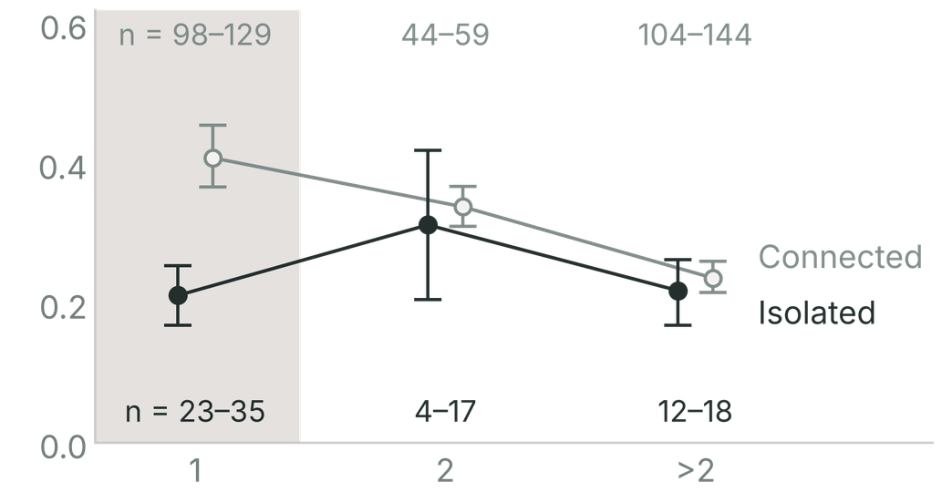
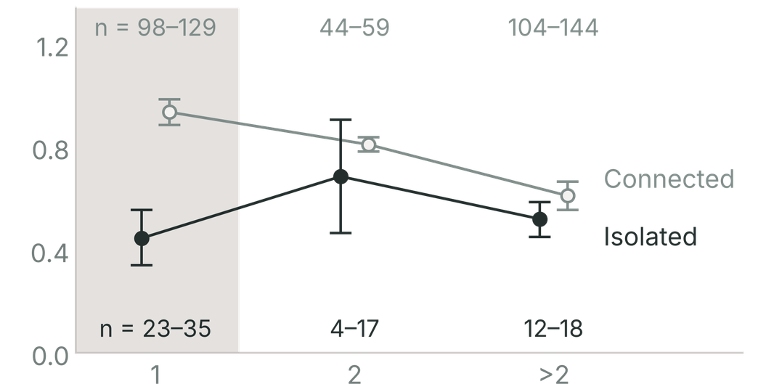
Rescue and immigration: Glanville fritillary butterfly
Fraction of increased populations
Production of new larval groups per group
Population size (larval groups of 50–100 larvae)
Population size (larval groups of 50–100 larvae)
Mean ± 1 SE, pooled over three annual transitions (1994–96); n = range of sample sizes
One larval group: isolated populations did worse on both measures
Larger populations: no significant difference between isolated and connected
Data: Kuussaari et al. 1998, Fig. 4; values digitised, approximate. Drawn with AI assistance (Claude)
Notes:
Slide notes:
Field data from the Aland Islands metapopulation in Finland. Population size is measured in larval groups (each typically 50-100 larvae before overwintering diapause).
How to read it: left = fraction of populations that increased; right = new larval groups produced per group. Bars compare isolated and connected populations; error bars are mean ± 1 SE, pooled over three annual transitions (1994-96).
What it shows: the smallest populations (one larval group) did worse on both measures when isolated. In larger populations, isolated and connected did not differ significantly. So the Allee effect showed up only in small, isolated populations, and connectivity (immigration) hid it. Without looking at connectivity, the authors would not have detected the Allee effect.

Slide 20
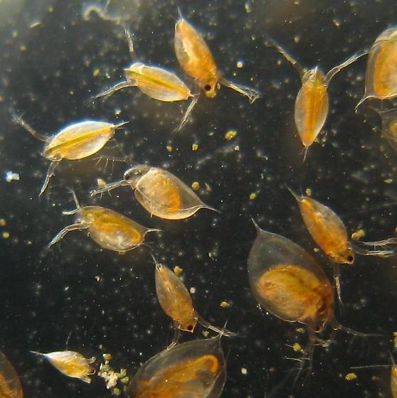
Evidence: experiment
Setup
Water fleas at different starting sizes, plus a predator
Result
Small populations died out faster
Blind spot
Shows the mechanism clearly, but only in a tank
Photo: Stephen Luk, BugGuide (© 2007)
Source: Kramer & Drake 2010
Notes:
Slide notes:
Setup: tanks of water fleas (Daphnia) at different starting sizes, plus a predator (a midge larva) that can only eat so fast. Because the predator's intake is capped, each flea in a small population is far more likely to be eaten.
Result: small populations died out faster, a predator-driven Allee effect causing extinction.
Strength: shows the mechanism clearly and controls density. Blind spot: only in a tank, so it may not reflect wild populations.

Slide 21
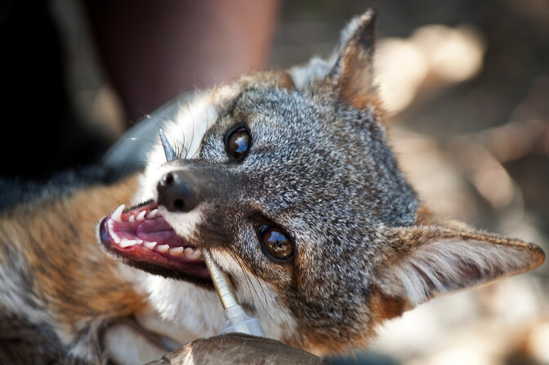
Evidence: field data
Setup
Fox populations on separate Channel Islands as natural replicates
Result
Costs won: a weak Allee effect
Blind spot
Net effect depends on how the components are weighed
Photo: Maya Sugarman, KPCC / LAist
Source: Angulo et al. 2007
Notes:
Slide notes:
Setup: island fox populations on separate Channel Islands, California, used as natural replicates. Numbers had crashed, largely because of golden eagles.
Result: in small populations two costs acted at once (a "double Allee effect"): higher per-capita eagle predation and lower mate finding. But there was also a benefit: less competition meant bigger litters and better pup survival. Overall the costs won, so small populations grew more slowly: a weak Allee effect.
Strength: real populations. Blind spot: the net effect depends on how the separate components are weighed, which is hard to untangle.

Slide 22
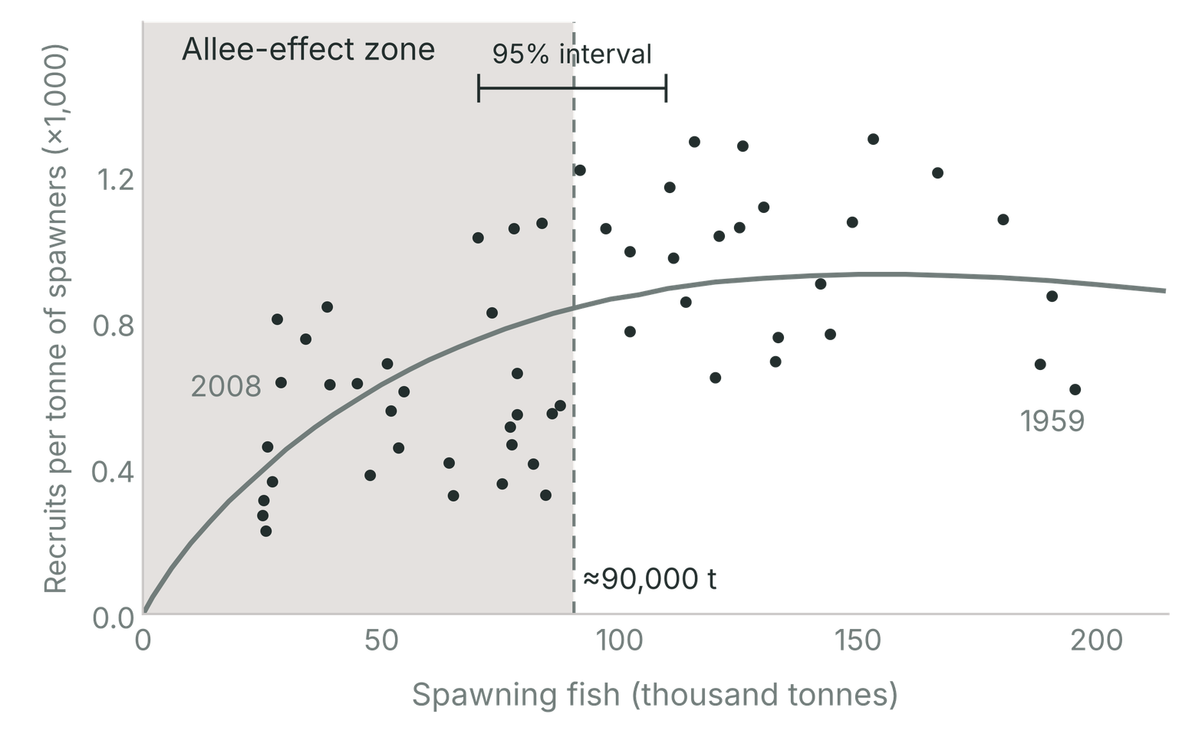
Evidence: long-term records
Setup
50 years of stock and recruitment records (1959-2008)
Not recovered after 30 years of
reduced fishing
Result
Each tonne of spawners produced fewer young
Blind spot
The evidence only became strong after the crash
● Each dot: one year, 1959-2008 (St Pierre Bank)
Data: Perälä et al. 2022, Fig. 2c; values digitised, approximate. Drawn with AI assistance (Claude)
Notes:
Slide notes:
Setup: Atlantic cod on St Pierre Bank, northwest Atlantic. Fifty years of stock and recruitment records (1959-2008). Stocks collapsed under fishing and have not recovered after 30 years of reduced fishing.
How to read it: each dot is one year. Horizontal axis = spawning stock biomass (tonnes of adults). Vertical axis = recruits per tonne of spawning stock, i.e. young produced per unit of adults.
Result: below roughly 90,000 t of spawning stock, recruits per tonne fell: adults produced fewer young per unit of stock. This is evidence of an Allee effect.
Blind spot: the evidence only became strong after the crash, because you cannot measure low-density dynamics until a population gets there. You often find the threshold after crossing it.

Slide 23
Two papers, 25 years apart
Defined in 1999, measured in 2024
Stephens et al. 1999
Defined the terms, no new data
Muir et al. 2024
Meta-analysis of 62 experimental studies
“Whilst theoreticians are principally concerned with demographic Allee effects, empiricists … are usually constrained to the quantification of component Allee effects.”
“Much of the theoretical literature on Allee effects has focused on demographic Allee effects … In comparison, most experimental work on Allee effects has focused on component Allee effects.”
Same gap, 25 years later: we mostly measure costs to individuals, not whole populations.
Quotes: Stephens et al. 1999, p. 187; Muir et al. 2024, p. 2
Notes:
[Zoe] Our assigned classic and modern papers are 25 years apart.
Allee spotted the effect in 1931, but Stephens and colleagues, in 1999, pinned down what actually counts: the split between component and demographic effects we saw earlier.
In 2024, Muir and colleagues combined 62 experiments and found the effect is real. But both papers describe the same gap. Theory is about whole populations, and the experiments mostly measure costs to individuals.
Slide notes:
Stephens et al. 1999 (classic) defined the terms, with no new data. Their key distinction is component (one fitness component) vs demographic (whole-population growth) Allee effects.
Muir et al. 2024 (modern) pooled 62 experimental studies in a meta-analysis. They found an overall positive Allee effect whose strength varied by mechanism (such as mate finding), not by taxonomic group. Some mechanisms, such as group living and predation, were not detectable on their own.
Both papers describe the same gap: theory is mostly about demographic effects, but experiments mostly measure component effects, i.e. costs to individuals rather than whole populations.

Slide 24
The stricter the test, the rarer the evidence
Experiments
62 studies
Clear effects, mostly costs to individuals
weaker test
Field: clear evidence, any kind
63 of 91
69%
Field: point of no return
7 of 91
8%
Wild records: population-level
13 of 1,198
1%
stricter test
Sources: Muir et al. 2024 · Kramer et al. 2009 · Gregory et al. 2010; separate datasets.
Notes:
[Zoe] So how strong is the evidence for whole populations? Those 62 experiments are the most controlled of the tests.
In the field, 63 of 91 studies found some sign of an Allee effect, but only 7 found a point of no return.
And across almost twelve hundred long-term records of wild populations, an Allee model fit best in just 13.
In a lab, you choose the density and measure one thing, like fertilised eggs. In the wild, you have to show the whole population grows slower when small, despite weather, predators and chance. And proving a point of no return is hardest of all because you’d have to catch a population falling past it.
So the stricter the test, the rarer the evidence.
Slide notes:
How to read it: moving from left to right, each test is stricter (harder to pass).
- Experiments: 62 studies pooled (Muir et al. 2024). Clear effects, but mostly costs to individuals.
- Field studies, any clear evidence: 63 of 91 (69%) (Kramer et al. 2009).
- Field studies showing a point of no return (strong Allee effect): 7 of 91 (8%) (Kramer et al. 2009).
- Wild population records where an Allee model fit best: 13 of 1,198 (1%) (Gregory et al. 2010).
Takeaway: the closer a test gets to whole wild populations and to a threshold, the rarer the evidence. That does not mean Allee effects are rare: weather, predators and chance make them hard to detect, and a threshold can only be proven once a population falls past it. These are separate datasets, so the numbers are not directly comparable.

Slide 25
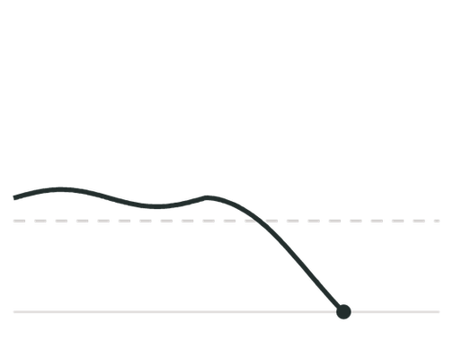
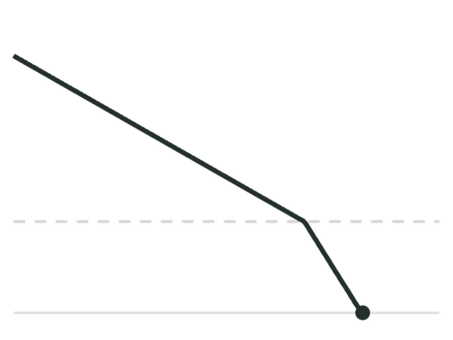
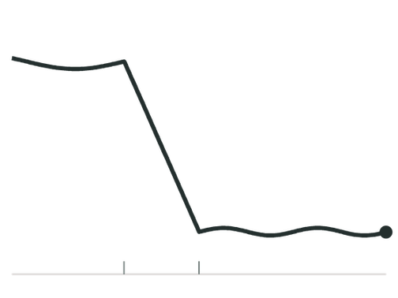
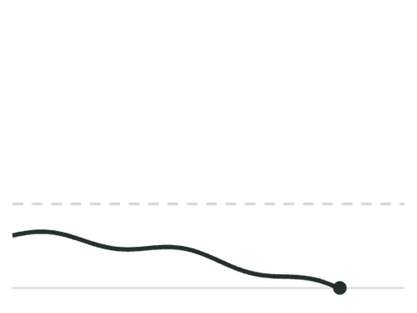
Hard to see, decisive when it counts
point of no return
harvest
Very small
Declining
Harvested
Newly arrived
Chance alone can tip it under
Slides past the threshold
Stays low after harvesting stops
Dies out before establishing: good news for pests
Population size over time; dashed line: point of no return (strong Allee effect)
Schematic, not data. Drawn with AI assistance (Claude)
Notes:
So Allee effects are hard to see: costs to individuals don’t always reach the population, weak effects leave no tipping point, and newcomers can hide them. But where they act, they can decide survival, in small, declining, harvested populations like cod, and new arrivals like the gypsy moth.
Slide notes:
Allee effects are hard to see: component costs do not always reach the population, weak effects have no tipping point, and immigrants can hide them. But where they act, they can decide survival. The dashed line is the point of no return of a strong Allee effect.
- Very small populations: chance alone can tip them below the threshold.
- Declining populations: they can slide past it.
- Harvested populations: may stay low after harvesting stops (as in cod).
- Newly arrived populations: may die out before establishing, which is good news for controlling invasive pests (as in the gypsy moth).

Slide 26
Neanderthals
Small population
Same Neanderthal photo as the intro
Scattered
Possibly cut off
Photo: Photaro, World History Encyclopedia (CC BY-SA 4.0)
Notes:
[Aron] Back to the Neanderthals: a small population, scattered across Europe, and possibly cut off from each other as modern humans spread between their groups, so no one could come to the rescue. Those are exactly the conditions where Allee effects decide the outcome.
Slide notes: Neanderthals had all the risk conditions: a small population, scattered across Europe, and possibly cut off from each other as modern humans spread between their groups, so no immigrants could rescue them. These are the conditions where Allee effects are most likely to decide the outcome.

Slide 27
Neanderthals
Same Neanderthal photo as the intro
Cause of extinction: unproven
Photo: Photaro, World History Encyclopedia (CC BY-SA 4.0)
Notes:
[Aron] But we can't prove that's what happened to them, and that's the point.
Slide notes: We cannot prove an Allee effect caused Neanderthal extinction. The model shows it was possible, not that it happened. This mirrors the evidence problem: Allee effects are hardest to demonstrate exactly when they matter most.

Slide 28
Curiosity or driver?
Not a curiosity, but a fundamental driver.
Decides the fate of small, declining, and harvested populations, often before we can detect it.
Notes:
[Aron] So the answer to our question: Allee effects are not a curiosity, but a fundamental driver. They decide the fate of small, declining and harvested populations, often before we can even detect them.
(pause)
Thank you. We’re happy to take questions.
Slide notes: Our answer: not a curiosity, but a fundamental driver. Allee effects are found across many taxa (Muir et al. 2024) and decide the fate of small, declining, harvested and newly arrived populations, often before we can detect them. The evidence is strongest for individual costs and weakest for population thresholds, which reflects how hard they are to measure, not that they are rare.

Slide 29






Group
Group Contributions
Aron: introduction, conclusion
Zoe: introduction, conclusion, slide design
Laaura: component, strong and weak Allee effects
Eren: demographic and strong Allee effect
Marco: rescue and immigration
Cristhiam: evidence
Aron Koçi
Zoe Ferencová
Laaura Mahsa Dashab
Eren Şengül
Marco Olukayode Otubushin
Cristhiam Alvarado Diaz

Slide 30
References
Allee, W.C. (1931) Animal Aggregations: A Study in General Sociology. University of Chicago Press, Chicago.
Allee, W.C. (1938) The Social Life of Animals. William Heinemann, London.
Angulo, E., Roemer, G.W., Berec, L., Gascoigne, J. & Courchamp, F. (2007) Double Allee effects and extinction in the island fox. Conservation Biology, 21, 1082–1091.
Angulo, E., Rasmussen, G.S.A., Macdonald, D.W. & Courchamp, F. (2013) Do social groups prevent Allee effect related extinctions? The case of wild dogs. Frontiers in Zoology, 10, 11.
Branco, M., Dokhelar, T., Brockerhoff, E.G., Liebhold, A.M. & Jactel, H. (2024) Widespread experimental evidence of Allee effects in insects: a meta-analysis. Entomologia Generalis, 44, 765–778.
Brashares, J.S., Werner, J.R. & Sinclair, A.R.E. (2010) Social ‘meltdown’ in the demise of an island endemic: Allee effects and the Vancouver Island marmot. Journal of Animal Ecology, 79, 965–973.
Brown, J.H. & Kodric-Brown, A. (1977) Turnover rates in insular biogeography: effect of immigration on extinction. Ecology, 58, 445–449.
Courchamp, F., Clutton-Brock, T. & Grenfell, B. (1999) Inverse density dependence and the Allee effect. Trends in Ecology & Evolution, 14, 405–410.
Drake, J.M. & Kramer, A.M. (2011) Allee effects. Nature Education Knowledge, 3(10), 2.
Gascoigne, J., Berec, L., Gregory, S. & Courchamp, F. (2009) Dangerously few liaisons: a review of mate-finding Allee effects. Population Ecology, 51, 355–372.
Gregory, S.D., Bradshaw, C.J.A., Brook, B.W. & Courchamp, F. (2010) Limited evidence for the demographic Allee effect from numerous species across taxa. Ecology, 91, 2151–2161.

Slide 31
References (cont.)
Grumbach, C. & Hilker, F.M. (2025) Allee pits in metapopulations: critical dispersal rates for connectivity to be beneficial. Theoretical Ecology, 18, 5.
Kramer, A.M., Dennis, B., Liebhold, A.M. & Drake, J.M. (2009) The evidence for Allee effects. Population Ecology, 51, 341–354.
Kramer, A.M. & Drake, J.M. (2010) Experimental demonstration of population extinction due to a predator-driven Allee effect. Journal of Animal Ecology, 79, 633–639.
Kuussaari, M., Saccheri, I., Camara, M. & Hanski, I. (1998) Allee effect and population dynamics in the Glanville fritillary butterfly. Oikos, 82, 384–392.
Liebhold, A. & Bascompte, J. (2003) The Allee effect, stochastic dynamics and the eradication of alien species. Ecology Letters, 6, 133–140.
Muir, E.J., Lajeunesse, M.J. & Kramer, A.M. (2024) The magnitude of Allee effects varies across Allee mechanisms, but not taxonomic groups. Oikos, 2024, e10386. ● class paper
Perälä, T., Hutchings, J.A. & Kuparinen, A. (2022) Allee effects and the Allee-effect zone in northwest Atlantic cod. Biology Letters, 18, 20210439.
Stephens, P.A., Sutherland, W.J. & Freckleton, R.P. (1999) What is the Allee effect? Oikos, 87, 185–190. ● class paper
Vaesen, K., Scherjon, F., Hemerik, L. & Verpoorte, A. (2019) Inbreeding, Allee effects and stochasticity might be sufficient to account for Neanderthal extinction. PLoS ONE, 14, e0225117.
Wang, M.-H. & Kot, M. (2001) Speeds of invasion in a model with strong or weak Allee effects. Mathematical Biosciences, 171, 83–97.
● Assigned class paper

Slide 32
Image credits and AI use
Slide
Image
Credit: creator, source (licence)
1, 26, 27
Neanderthal model
Photaro, World History Encyclopedia (CC BY-SA 4.0)
8
Sea urchins
UC Irvine Samueli School of Engineering news (no credit given)
8
Vancouver Island marmots
Wired (photographer: see credit under photo)
8
African wild dogs
Conscious Explorer magazine (no credit given)
8
Bark beetles
Crested Butte News (no credit given)
11
African wild dog pups
Sabi Sabi Private Game Reserve, via Africa Endeavours
13
Flour beetle (Tribolium)
Local Hero pest control blog (no credit given)
15
Gypsy (spongy) moth
Tamás Nestor, Butterfly Conservation
20
Water fleas (Daphnia)
Stephen Luk, BugGuide (© 2007)
21
Island fox
Maya Sugarman, KPCC / LAist
10
Elephant icons
Canva
2, 5, 6
Base map of Europe
Natural Earth (public domain); Drawn with AI assistance (Claude)
AI use. We used Claude to reconstruct the charts marked “Drawn with AI assistance (Claude)” from the published figures and models named in each footer. The group checked every reconstruction against the original figure. We also used AI to help us find papers, organize our sources (and keep track of them for our reference slide), and double check the facts in our final product against the papers we used.

Slide 33
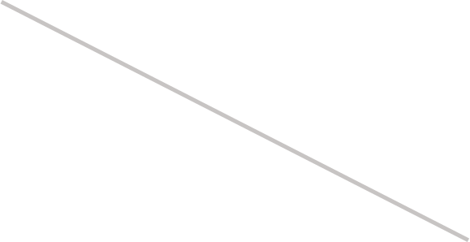
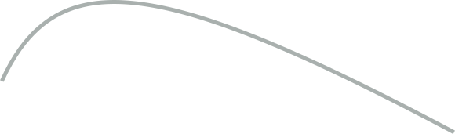
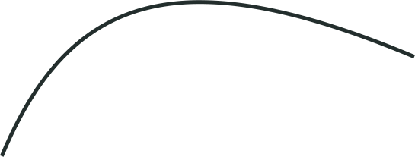
Study guide: key terms
1 / 3
Allee effect
The smaller the population, the lower each individual’s chance of surviving or reproducing.
Growth per individual
No Allee effect
Component Allee effect
One part of fitness, like pup survival or mating success, gets worse at low numbers.
Example: African wild dogs
Weak
Demographic Allee effect
The costs add up: growth per individual of the whole population falls at low numbers.
Example: Vancouver Island marmots
Strong
Weak Allee effect
Small populations grow more slowly, but growth stays positive. No threshold.
Example: Channel Island foxes
0
Allee threshold
below it, growth < 0
Strong Allee effect
Below a critical size, the Allee threshold, growth turns negative: more die than are born.
Example: Gypsy moth, ≈107 males per colony
Population size →
Immigrants from connected populations top up a small one. Isolated ones get no rescue.
Example: Glanville fritillary
Schematic, not data. Drawn with AI assistance (Claude)
Rescue effect
Being few also means less competition. A cost to individuals only shows up in the population if it outweighs that.
Sources: Stephens et al. 1999 · Angulo et al. 2013 · Brashares et al. 2010 · Angulo et al. 2007 · Liebhold & Bascompte 2003 · Kuussaari et al. 1998

Slide 34
Study guide: how to spot each one
2 / 3
Concept
Plot against population size
What you would see
Example from our talk
Component
One fitness measure (survival, mating success, pups per adult)
Rises with group or population size
Wild dogs: pup survival rose with pack size up to ≈12, with no population-level effect
Demographic
Growth per individual of the whole population
Lower growth at smaller sizes
Marmots: growth went negative at small sizes (38 years of counts; correlational)
Weak
Growth per individual at low numbers
Reduced, but still above zero
Island foxes: costs beat bigger litters, so small populations grew more slowly
Strong
Where growth per individual crosses zero
Negative below a threshold
Gypsy moth: growth negative below ≈107 males trapped per colony
Rescue
Connected vs isolated small populations
Isolated ones do worse; no gap when large
Glanville fritillary: one-larval-group populations did worse when isolated
Note: immigration can hurt too. In a two-patch model, dispersal can rescue a small patch or drain one below its threshold, an “Allee pit”. Which one happens depends on how strong the Allee effect is.
Sources: Angulo et al. 2013 · Brashares et al. 2010 · Angulo et al. 2007 · Liebhold & Bascompte 2003 · Kuussaari et al. 1998 · Grumbach & Hilker 2025

Slide 35
Study guide: the evidence and our answer
3 / 3
Three ways to look for an Allee effect
Experiment
Field data
Long-term records
Water fleas + a predator: small populations died out faster
Island foxes on separate islands: costs won, a weak effect
Atlantic cod: below ≈90,000 t, each adult produced fewer young
Strength Mechanism shown clearly
Blind spot Only in a tank
Strength Real populations
Blind spot Hard to untangle the components
Strength Whole population, decades
Blind spot Evidence only strong after the crash
The stricter the test, the rarer the evidence
62
7 of 91
13 of 1,198
experiments pooled: the effect is real; its size depends on mechanism, not taxon
field studies found a point of no return (63 found some sign)
long-term records fit an Allee model best
Classic vs modern
Stephens 1999 defined component vs demographic. Muir 2024 measured it. Same gap: theory is about populations, experiments measure individuals.
Our answer
Not a curiosity, but a fundamental driver: it decides the fate of small, declining, harvested and newly arrived populations, often before we can detect it.
Sources: Kramer & Drake 2010 · Angulo et al. 2007 · Perälä et al. 2022 · Muir et al. 2024 · Kramer et al. 2009 · Gregory et al. 2010 · Stephens et al. 1999

